Slide 1
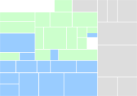
CBM Retail Map
Buying
Logistics
Selling
Not covered
Suppliers
Products
Store & Channel
Marketing & Customer Management
Distribution & Warehousing
Direct
S-D.1 Supplier Relationship Strategy
P-D.1 Merchandise / Brand Strategy
C-D.1 Store & Channel Strategy
M-D.1 Customer Relationship Strategy
D-D.1 Distribution, Ware-house, SC Strategy
S-D.2 Supplier Relationship Planning
P-D.2 Merchandise Planning
C-D.2 Real Estate
Planning and Development
M-D.2 Marketing Strategy & CBM Retail MapPlanning
D-D.2 Site and Transportation Planning
S-D.3 Supplier Relationship Management
P-D.3 Assortment Planning
C-D.3 Merchandise & Location Planning
P-D.4 Category Management
D-D.3 Transportation Strategic Partnerships
Execute
S-E.1 Supplier Operations Management
P-E.1 Sourcing and Listing
C-E.1 Store and Channel
Design & Layout
M-E.1 Mass Marketing and Advertising
D-E.1 Foreign Trade
S-E.2 Supplier Transaction Management
P-E.2 Purchase Order Management
C-E.2 Space Planning
M-E.2 Target Marketing
D-E.2 Transportation / Fleet Management
P-E.3 Import & Customs
C-E.3 Visual Merchandising
M-E.3 Loyalty Program
D-E.3 In-bound Logistics
P-E.4 Master Data Management*
P-E.5 Allocation
C-E.4 Price / Promotions Management
M-E.4 Customer Service and Communications
D-E.4 Distribution Center Operations
P-E.6 Replenishment
C-E.5 Store and Channel Operations
M-E.5 Multi Channel Call Center
D-E.5 Intra-company & Outbound Logistics
M-E.6 Complaint Management
D-E.6 Returns
Control
S-C.1 Supplier Performance Management
P-C.1 Product Performance Management
C-C.1 Store Operations Central Control
M-C.1 Market & Competitor Research
D-C.1 Tracking & Tracing
S-C.2 Supplier Lifecycle Management
P-C.2 Merchandise Plan Tracking
C-C.2 Merchandise & Location Plan Tracking
M-C.2 Consumer Behavior and Segmentation
D-C.2 Supply Chain Performance Management
P-C.3 Product Lifecycle Management
C-C.3 Store Lifecycle Management
M-C.3 Consumer Performance Management
M-C.4 Consumer Lifecycle Management
* Covered by other Business Components
Notes:
This is a generic component map for retail. The map is organized vertically by competency, and horizontally by operational level.
The three levels used in CBM are:
Plan is about strategy, overall direction and policy.
Manage is about monitoring, managing exceptions and tactical decision making
Execute is about doing the work

Slide 2
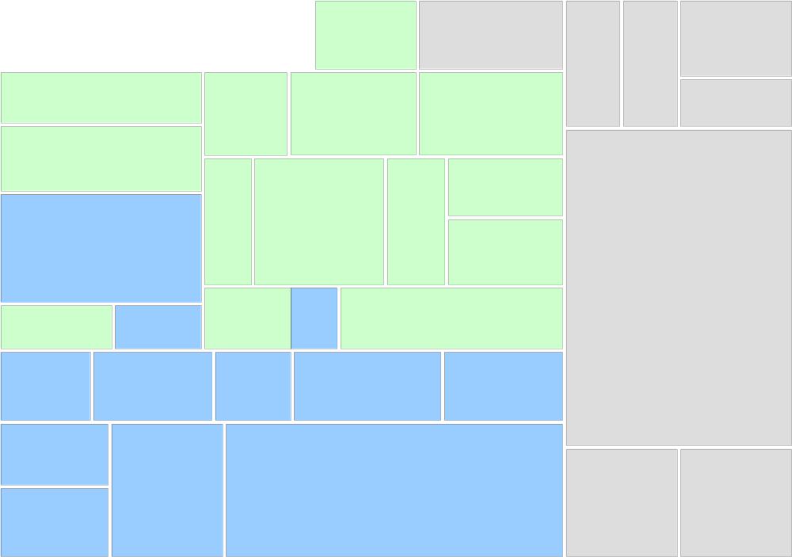
Main Flow of Planning
P-E.3 Import & Customs
D-E.1 Foreign Trade
D-D.1 Distribution, Warehouse, SC Strategy
Main Physical Flow of Merchandise
D-E.3 In-bound Logistics
D-C.1 Tracking & Tracing
P-D.1 Merchandise / Brand Strategy
S-D.3 Supplier Relationship Management
S-E.1 Supplier
Operations
Management
P-E.5 Allocation
D-C.2 Supply Chain Performance Management
P-D.2 Merchandise Planning
D-E.4 Distribution Center Operations
P-E.1 Sourcing and Listing
S-C.1 Supplier Performance Management
P-D.3 Assortment Planning
P-E.2 Purchase
Order Management
C-D.3 Merchandise & Location Planning
P-C.1 Product Performance Management
C-E.2 Space Planning
P-E.6 Replenishment
P-C.2
Merchandise
Plan Tracking
C-C.2 Merch & Loc Plan Tracking
C-D.1 Store
& Channel
Strategy
C-D.2 Real Estate
Planning and Development
C-E.1 Store Channel
Design &
Layout
C-E.3 Visual Merchandising
C-E.4 Price / Promotions Management
M-E.1 Mass Marketing and Advertising
C-C.1 Store Operations Central Control
C-E.5 Store and Channel Operations
D-E.5 Intra-company & Outbound Logistics
M-E.6 Complaint Management
D-E.6 Returns
Notes:
This is a generic component map for retail. The map is organized vertically by competency, and horizontally by operational level.
The three levels used in CBM are:
Plan is about strategy, overall direction and policy.
Manage is about monitoring, managing exceptions and tactical decision making
Execute is about doing the work

Slide 3
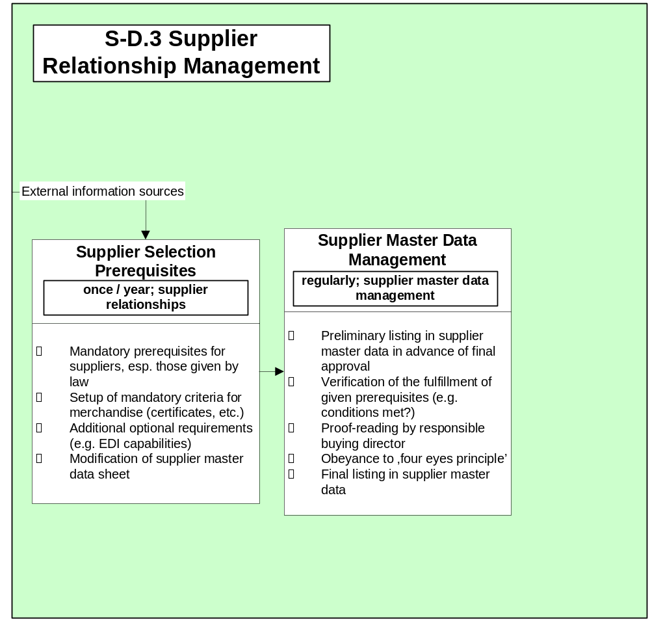
S-D.3 Supplier Relationship Management
Supplier
Contract
Management
Sourcing and
Listing
Item Master
Data Management
Notes:
This is a generic component map for retail. The map is organized vertically by competency, and horizontally by operational level.
The three levels used in CBM are:
Plan is about strategy, overall direction and policy.
Manage is about monitoring, managing exceptions and tactical decision making
Execute is about doing the work

Slide 4
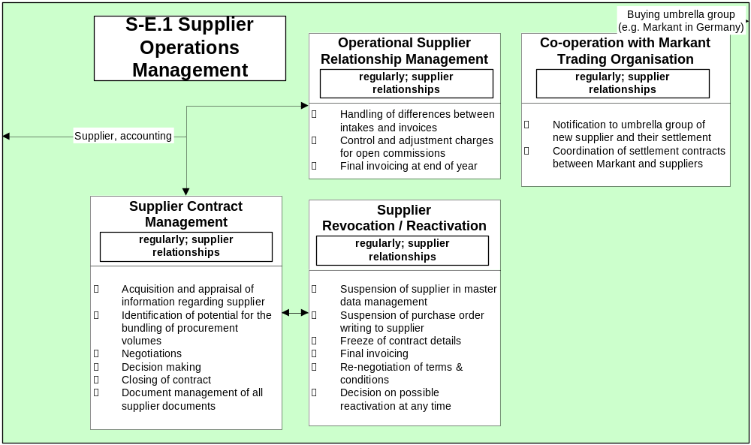
S-E.1 Supplier Operations Management
Supplier
Performance
Management
Supplier
Master
Data
Manage-
ment
Notes:
This is a generic component map for retail. The map is organized vertically by competency, and horizontally by operational level.
The three levels used in CBM are:
Plan is about strategy, overall direction and policy.
Manage is about monitoring, managing exceptions and tactical decision making
Execute is about doing the work

Slide 5
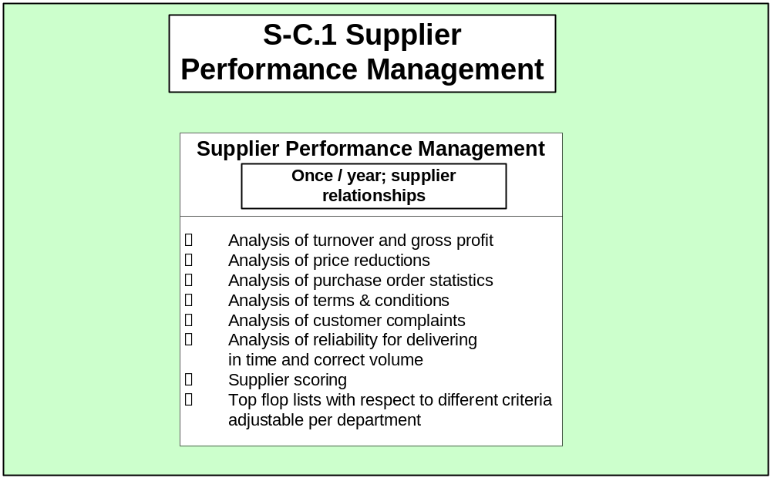
S-C.1 Supplier Performance Management
Supplier
Revocation /
Reactivation
Product
Performance
Management
Notes:
This is a generic component map for retail. The map is organized vertically by competency, and horizontally by operational level.
The three levels used in CBM are:
Plan is about strategy, overall direction and policy.
Manage is about monitoring, managing exceptions and tactical decision making
Execute is about doing the work

Slide 6
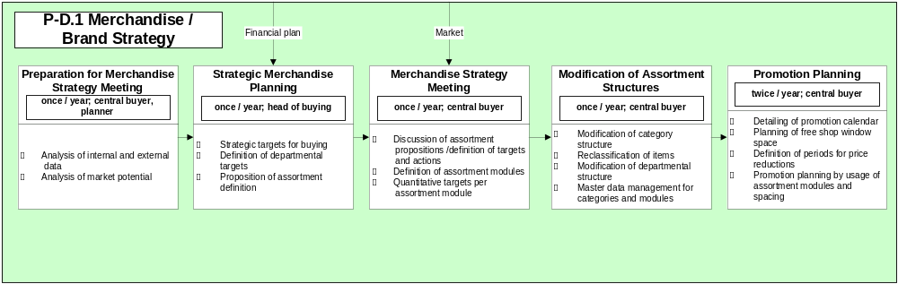
P-D.1 Merchandise / Brand Strategy
Planning of
Store Budgets
Merchandise Planning
(Department / Class Level)
Merchandise Planning
(Category Level)
Promotion
Calendar
Notes:
This is a generic component map for retail. The map is organized vertically by competency, and horizontally by operational level.
The three levels used in CBM are:
Plan is about strategy, overall direction and policy.
Manage is about monitoring, managing exceptions and tactical decision making
Execute is about doing the work

Slide 7
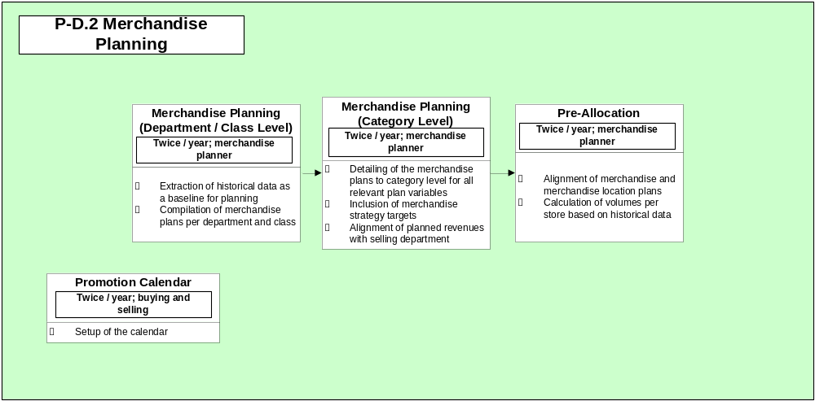
P-D.2 Merchandise Planning
Modification of
Assortment Structures
Merchandise
Strategy Meeting
Merchandise
& Location
Planning
(Department Level)
Purchase Order
Management
Assortment Planning
Promotion
Planning
Merchandise Forecast / Actuals versus Plan
Space Planning (Dep‘t Level)
Advertising
Merchandise & Location
Planning (Category Level)
Notes:
This is a generic component map for retail. The map is organized vertically by competency, and horizontally by operational level.
The three levels used in CBM are:
Plan is about strategy, overall direction and policy.
Manage is about monitoring, managing exceptions and tactical decision making
Execute is about doing the work

Slide 8
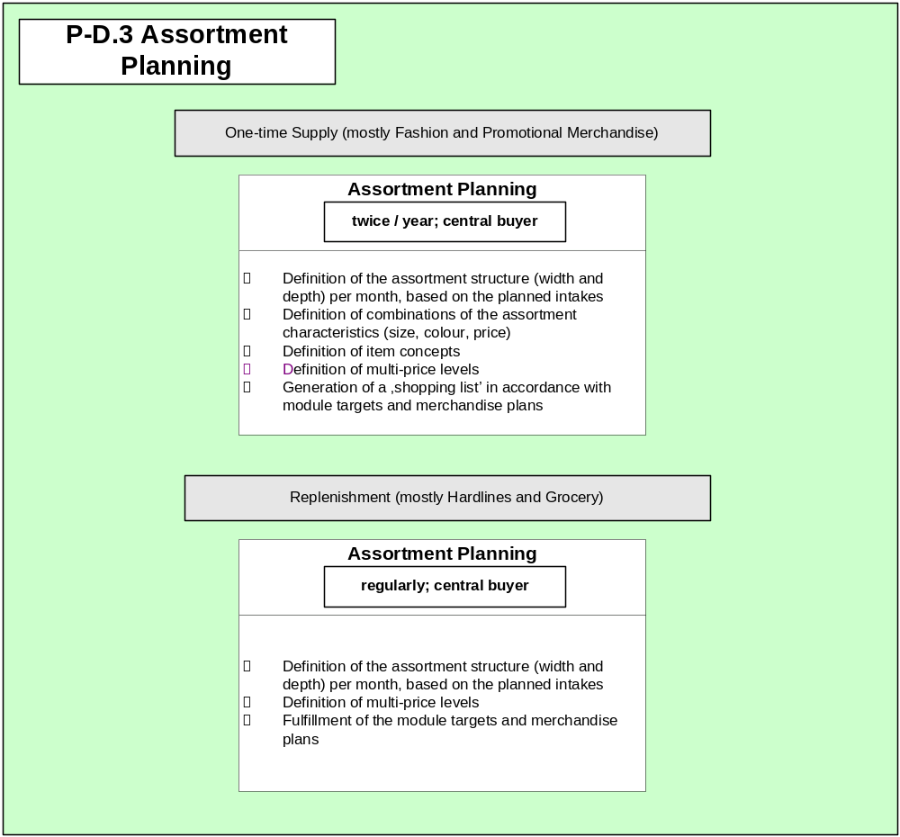
P-D.3 Assortment Planning
Merchandise
Planning
(Category Level)
Sourcing and
Listing
Merchandise
Planning
(Category Level)
Sourcing and
Listing
Notes:
This is a generic component map for retail. The map is organized vertically by competency, and horizontally by operational level.
The three levels used in CBM are:
Plan is about strategy, overall direction and policy.
Manage is about monitoring, managing exceptions and tactical decision making
Execute is about doing the work

Slide 9
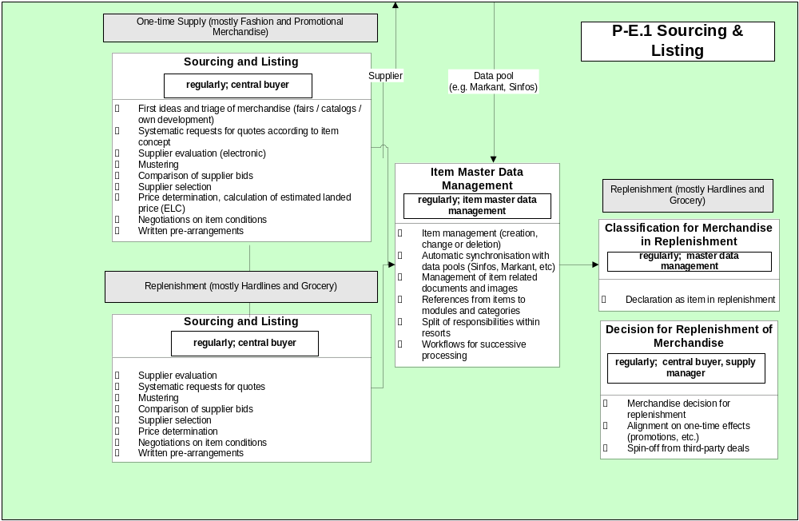
P-E.1 Sourcing & Listing
Supplier
Selection
Prerequi-
sites
Supplier Master
Data Management
Assortment
Planning
Purchase Order
Management
Assortment
Planning
Product Performance
Management
Replenishment Planning
Notes:
This is a generic component map for retail. The map is organized vertically by competency, and horizontally by operational level.
The three levels used in CBM are:
Plan is about strategy, overall direction and policy.
Manage is about monitoring, managing exceptions and tactical decision making
Execute is about doing the work

Slide 10
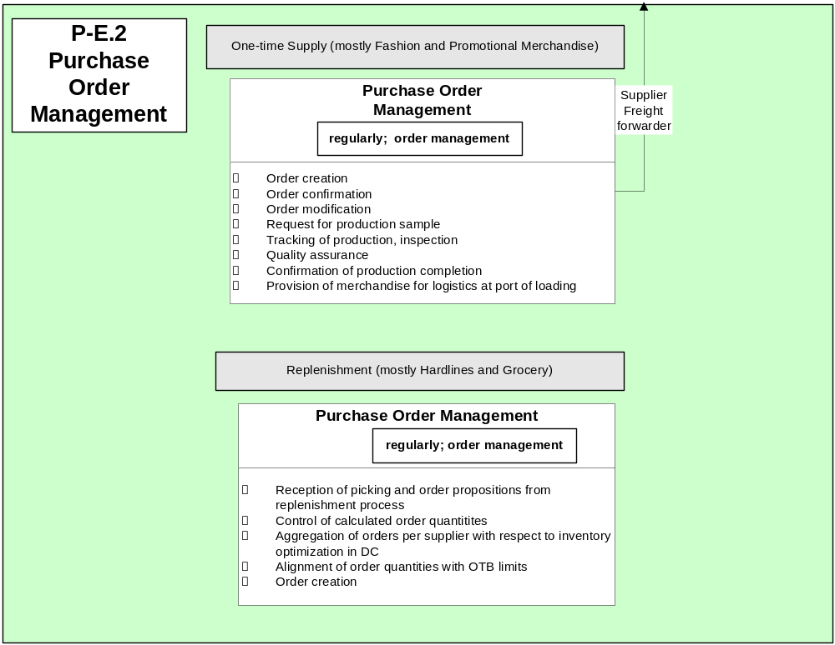
P-E.2 Purchase Order Management
Item Master
Data Management
Trade Agency
Management
Pre-Allocation
Allocation
Data Retrieval
Replenishment
Quality Assurance
and Release
Store Demand
Identification
Inventory
Optimization
Notes:
This is a generic component map for retail. The map is organized vertically by competency, and horizontally by operational level.
The three levels used in CBM are:
Plan is about strategy, overall direction and policy.
Manage is about monitoring, managing exceptions and tactical decision making
Execute is about doing the work

Slide 11
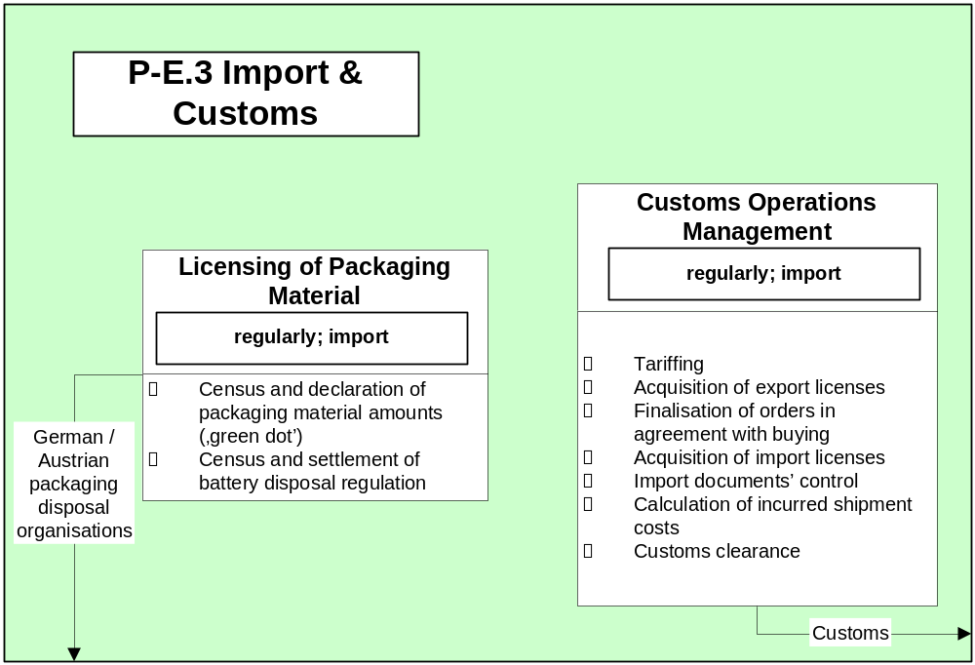
P-E.3 Import & Customs
Trade Agency
Management
Notes:
This is a generic component map for retail. The map is organized vertically by competency, and horizontally by operational level.
The three levels used in CBM are:
Plan is about strategy, overall direction and policy.
Manage is about monitoring, managing exceptions and tactical decision making
Execute is about doing the work

Slide 12
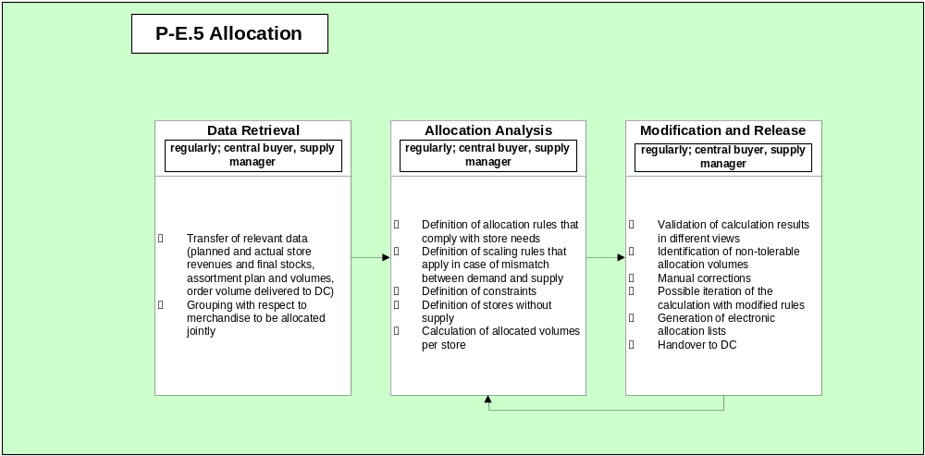
P-E.5 Allocation
Purchase Order
Management
Store Demand
Identification
Notes:
This is a generic component map for retail. The map is organized vertically by competency, and horizontally by operational level.
The three levels used in CBM are:
Plan is about strategy, overall direction and policy.
Manage is about monitoring, managing exceptions and tactical decision making
Execute is about doing the work

Slide 13
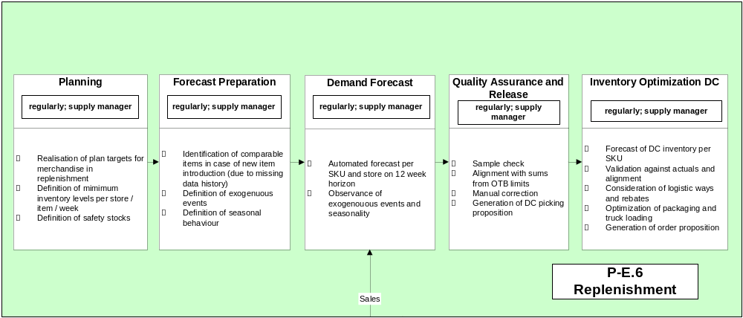
P-E.6 Replenishment
Decision for Replenishment
of Merchandise
Purchase Order
Management
Purchase Order
Management
Notes:
This is a generic component map for retail. The map is organized vertically by competency, and horizontally by operational level.
The three levels used in CBM are:
Plan is about strategy, overall direction and policy.
Manage is about monitoring, managing exceptions and tactical decision making
Execute is about doing the work

Slide 14
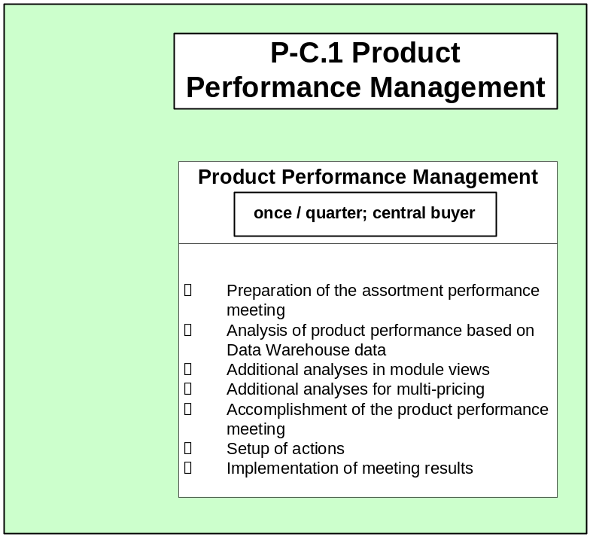
P-C.1 Product Performance Management
Sourcing
and
Listing
Supplier
Performance
Management
Notes:
This is a generic component map for retail. The map is organized vertically by competency, and horizontally by operational level.
The three levels used in CBM are:
Plan is about strategy, overall direction and policy.
Manage is about monitoring, managing exceptions and tactical decision making
Execute is about doing the work

Slide 15
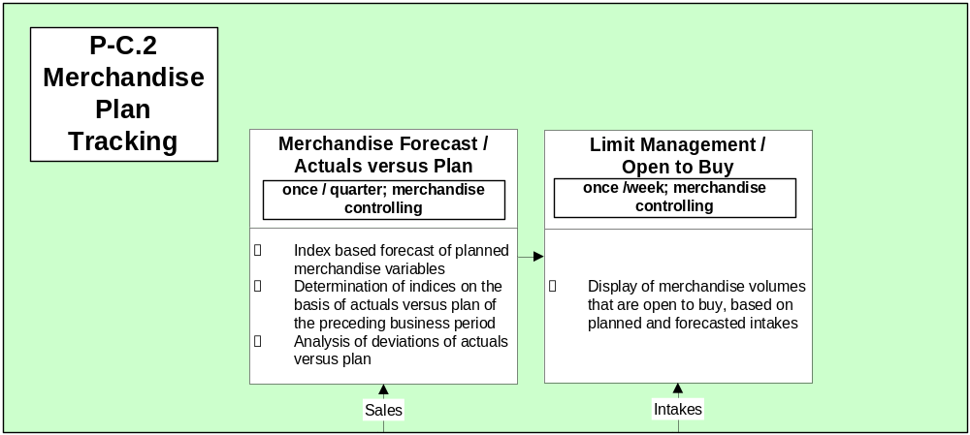
P-C.2 Merchandise Plan Tracking
Merchandise Planning
(Category Level)
Purchase
Order
Management
Notes:
This is a generic component map for retail. The map is organized vertically by competency, and horizontally by operational level.
The three levels used in CBM are:
Plan is about strategy, overall direction and policy.
Manage is about monitoring, managing exceptions and tactical decision making
Execute is about doing the work

Slide 16
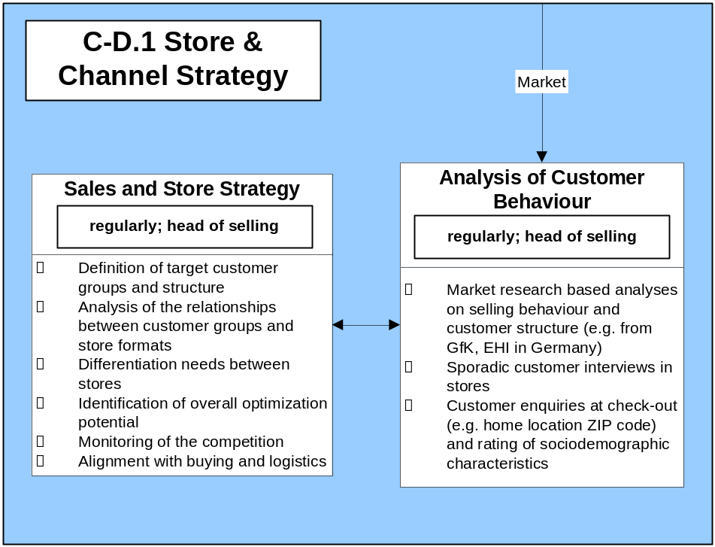
C-D.1 Store & Channel Strategy
Store Formats
Site Planning
Notes:
This is a generic component map for retail. The map is organized vertically by competency, and horizontally by operational level.
The three levels used in CBM are:
Plan is about strategy, overall direction and policy.
Manage is about monitoring, managing exceptions and tactical decision making
Execute is about doing the work

Slide 17
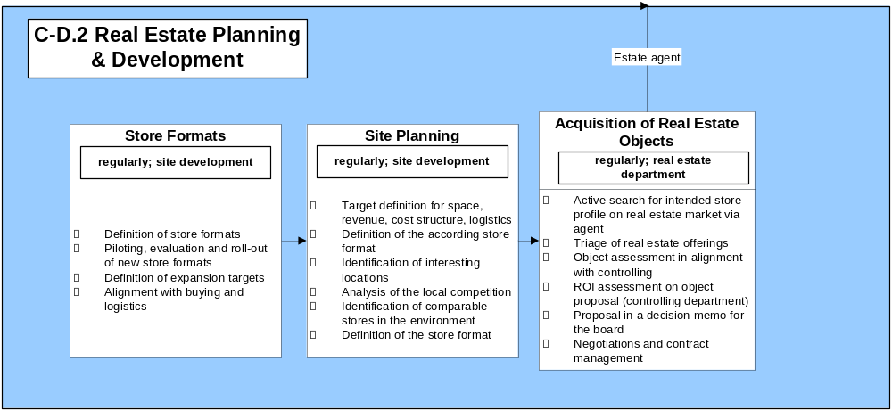
C-D.2 Real Estate Planning & Development
Analysis of Customer
Behaviour
Sales & Store
Strategy
Openings /
Reconstructions
Notes:
This is a generic component map for retail. The map is organized vertically by competency, and horizontally by operational level.
The three levels used in CBM are:
Plan is about strategy, overall direction and policy.
Manage is about monitoring, managing exceptions and tactical decision making
Execute is about doing the work

Slide 18
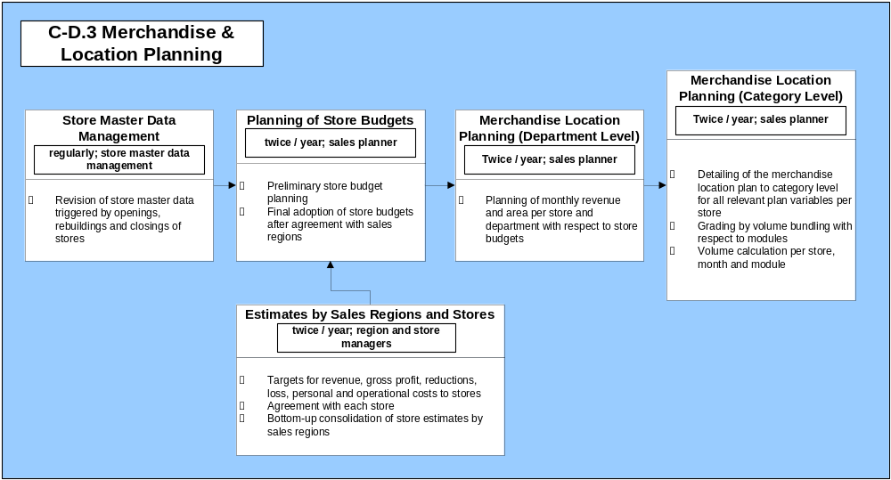
C-D.3 Merchandise & Location Planning
Merchandise Planning
(Category Level)
Strategic Merchandise
Planning
Merchandise Planning
(Department / Class Level)
Openings /
Reconstructions
Space Planning (Store Level)
Merchandise Location Forecast /
Actuals versus Plan
Notes:
This is a generic component map for retail. The map is organized vertically by competency, and horizontally by operational level.
The three levels used in CBM are:
Plan is about strategy, overall direction and policy.
Manage is about monitoring, managing exceptions and tactical decision making
Execute is about doing the work

Slide 19
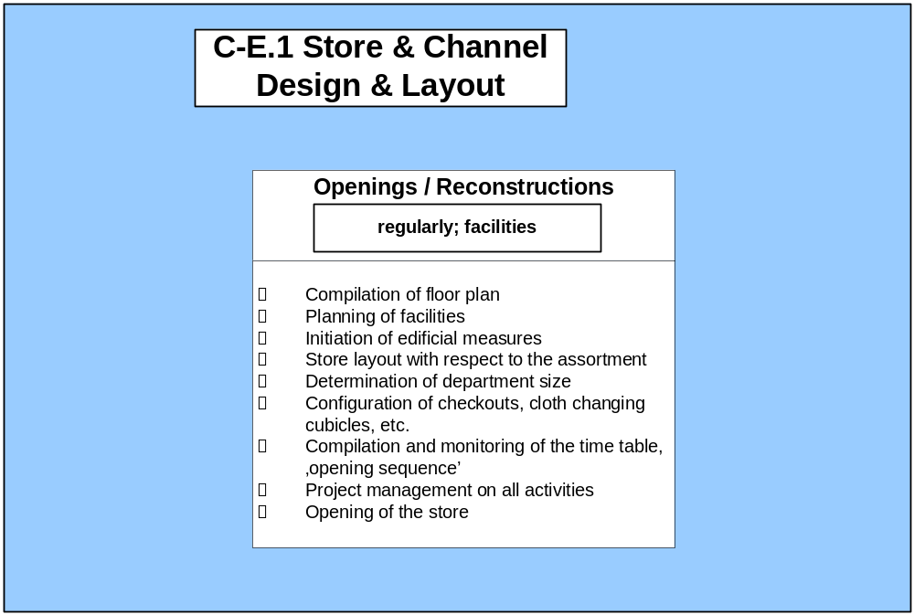
C-E.1 Store & Channel Design & Layout
Space Planning
(Store Level)
Acquisition of
Real Estate
Objects
Store Master Data
Management
Notes:
This is a generic component map for retail. The map is organized vertically by competency, and horizontally by operational level.
The three levels used in CBM are:
Plan is about strategy, overall direction and policy.
Manage is about monitoring, managing exceptions and tactical decision making
Execute is about doing the work

Slide 20
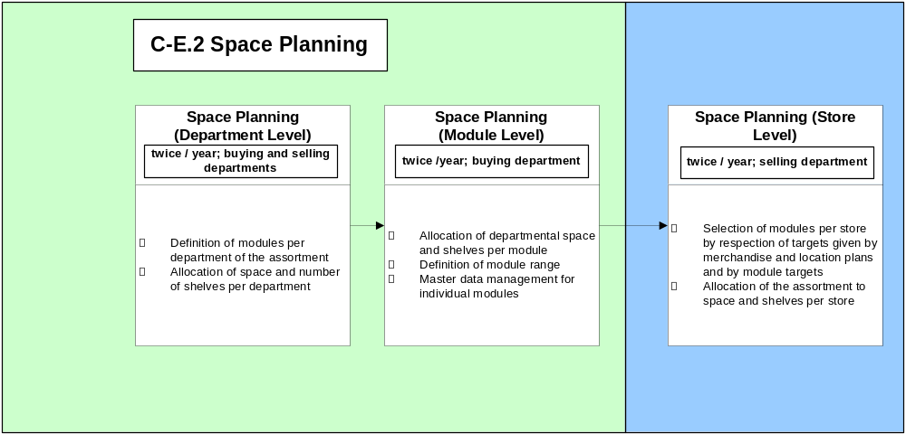
C-E.2 Space Planning
Openings /
Reconstructions
Merchandise Location
Planning (Category Level)
Merchandise
Planning
(Category Level)
Planogram
Compilation
Notes:
This is a generic component map for retail. The map is organized vertically by competency, and horizontally by operational level.
The three levels used in CBM are:
Plan is about strategy, overall direction and policy.
Manage is about monitoring, managing exceptions and tactical decision making
Execute is about doing the work

Slide 21
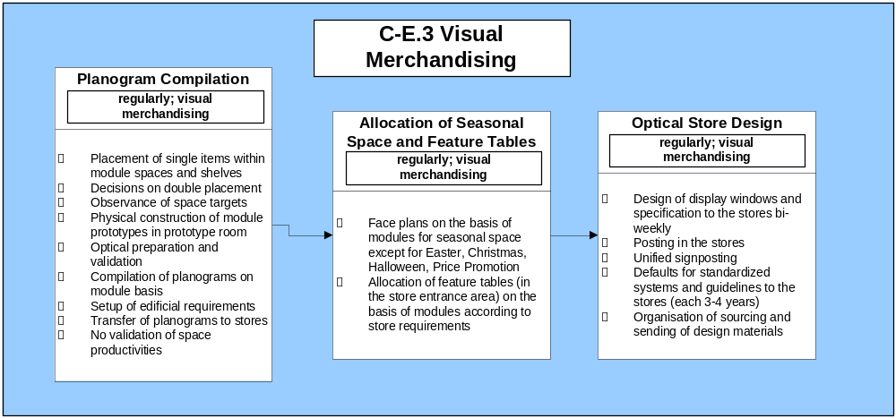
C-E.3 Visual Merchandising
Space Planning
(Store Level)
Assortment Presentation
Store Design
Notes:
This is a generic component map for retail. The map is organized vertically by competency, and horizontally by operational level.
The three levels used in CBM are:
Plan is about strategy, overall direction and policy.
Manage is about monitoring, managing exceptions and tactical decision making
Execute is about doing the work

Slide 22
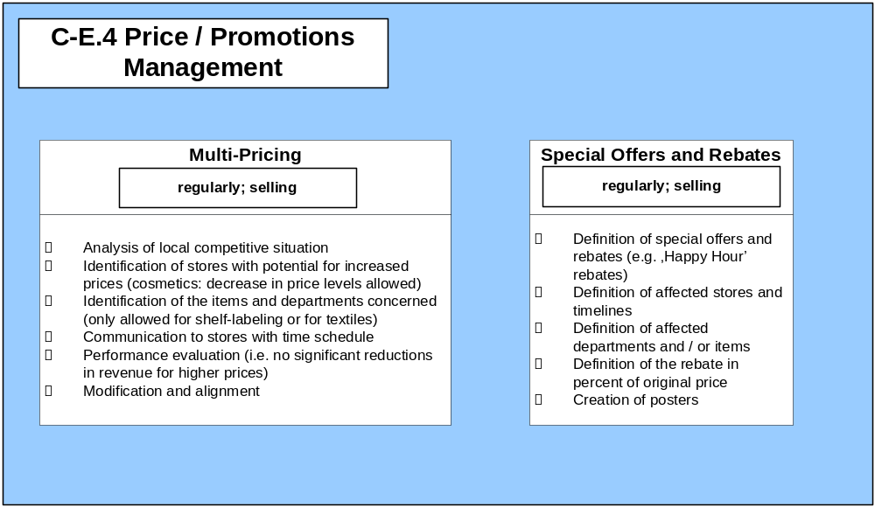
C-E.4 Price / Promotions Management
Merchandise Placement &
Price Labelling
Merchandise Placement &
Price Labelling
Notes:
This is a generic component map for retail. The map is organized vertically by competency, and horizontally by operational level.
The three levels used in CBM are:
Plan is about strategy, overall direction and policy.
Manage is about monitoring, managing exceptions and tactical decision making
Execute is about doing the work

Slide 23
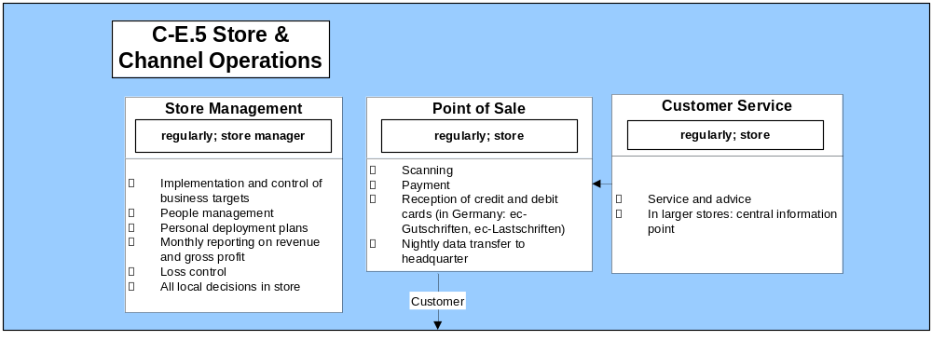
C-E.5 Store & Channel Operations
(Sales & Service)
C-E.5 Store &
Channel
Operations
(Store Design / Merchandise Placement)
Management per
Sales Channel
and Sales Region
Inventory Management
Notes:
This is a generic component map for retail. The map is organized vertically by competency, and horizontally by operational level.
The three levels used in CBM are:
Plan is about strategy, overall direction and policy.
Manage is about monitoring, managing exceptions and tactical decision making
Execute is about doing the work

Slide 24
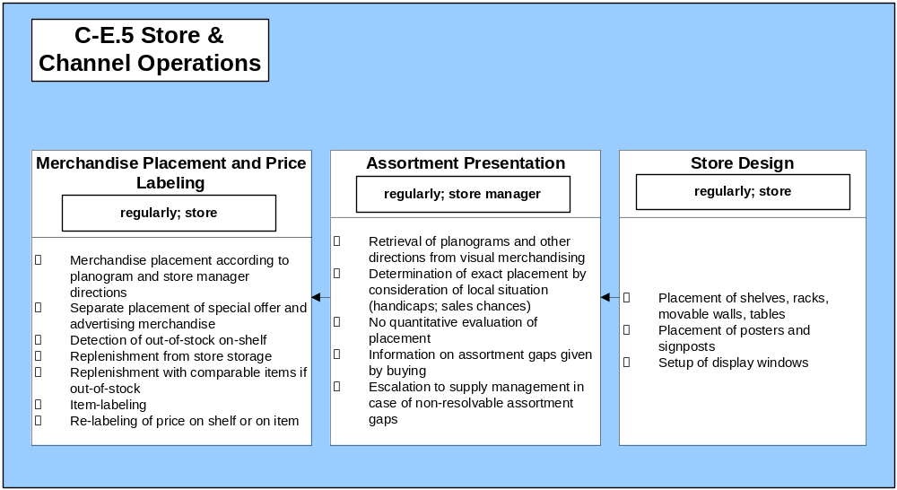
C-E.5 Store & Channel Operations
(Store Design / Merchandise Placement)
Multi-Pricing
Special Offers
and Rebates
Planogram
Compilation
Optical Store
Design
C-E.5 Store &
Channel
Operations
(Sales & Service)
C-E.5 Store &
Channel
Operations
(Back Office &
Inventory
Management)
Storage in Store
Notes:
This is a generic component map for retail. The map is organized vertically by competency, and horizontally by operational level.
The three levels used in CBM are:
Plan is about strategy, overall direction and policy.
Manage is about monitoring, managing exceptions and tactical decision making
Execute is about doing the work

Slide 25
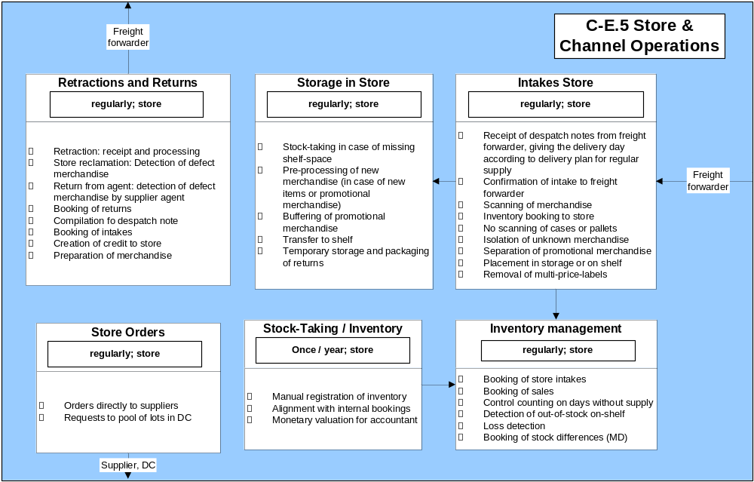
C-E.5 Store & Channel Operations
(Back Office and Inventory Management)
Merchandise Claims
/ Returns
Returns Administration DC
Merchandise Placement
& Price Labelling
Outbound
Logistics
Transport
Monitoring
& Control
C-E.5 Store &
Channel
Operations
(Store
Design / Merchandise
Placement)
Point of Sale
Notes:
This is a generic component map for retail. The map is organized vertically by competency, and horizontally by operational level.
The three levels used in CBM are:
Plan is about strategy, overall direction and policy.
Manage is about monitoring, managing exceptions and tactical decision making
Execute is about doing the work

Slide 26
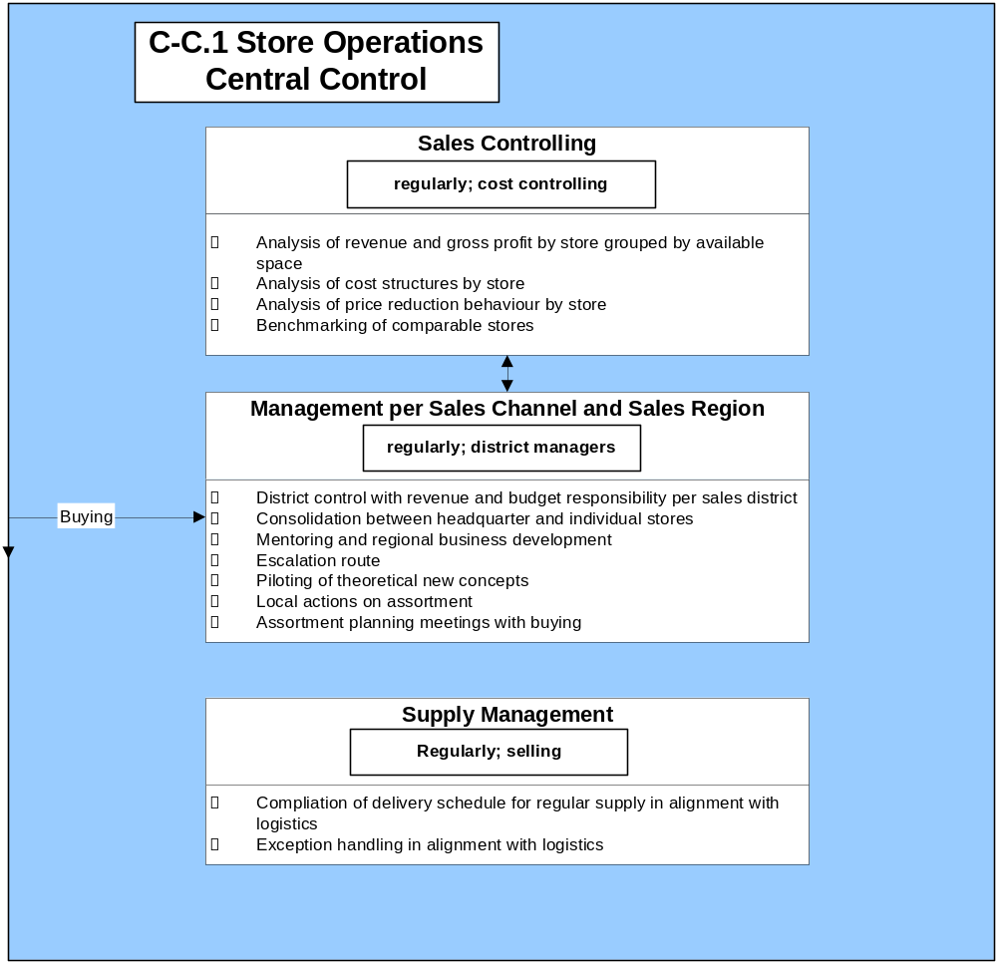
C-C.1 Store Operations Central Control
Store
Management
Advertising
Compilation of
Deliver Schedule
for Regular
Supply
Notes:
This is a generic component map for retail. The map is organized vertically by competency, and horizontally by operational level.
The three levels used in CBM are:
Plan is about strategy, overall direction and policy.
Manage is about monitoring, managing exceptions and tactical decision making
Execute is about doing the work

Slide 27
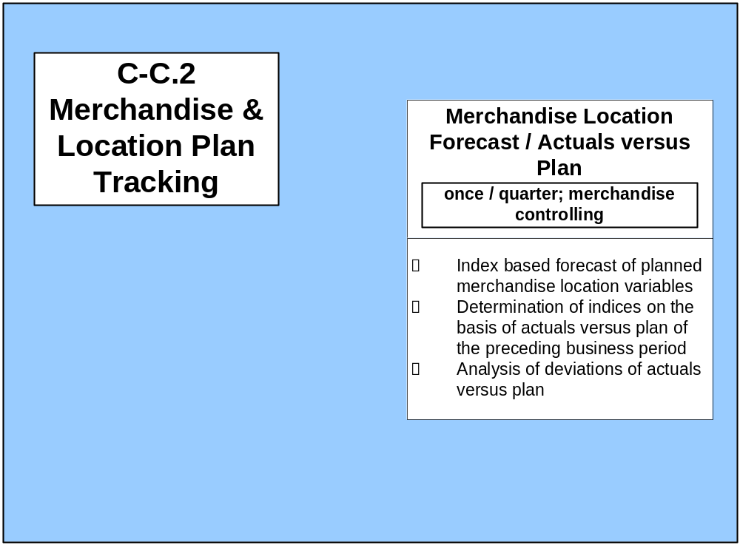
C-C.2 Merchandise & Location Plan Tracking
Merchandise & Location
Planning
(Category Level)
Notes:
This is a generic component map for retail. The map is organized vertically by competency, and horizontally by operational level.
The three levels used in CBM are:
Plan is about strategy, overall direction and policy.
Manage is about monitoring, managing exceptions and tactical decision making
Execute is about doing the work

Slide 28
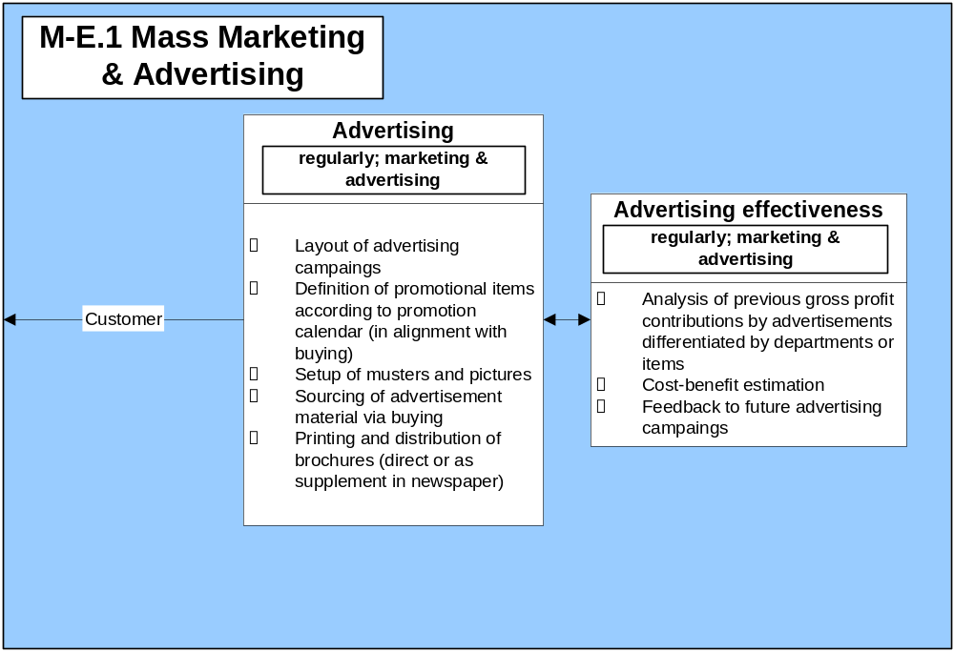
M-E.1 Mass Marketing & Advertising
Advertisement
Calendar
Supply
Management
Notes:
This is a generic component map for retail. The map is organized vertically by competency, and horizontally by operational level.
The three levels used in CBM are:
Plan is about strategy, overall direction and policy.
Manage is about monitoring, managing exceptions and tactical decision making
Execute is about doing the work

Slide 29
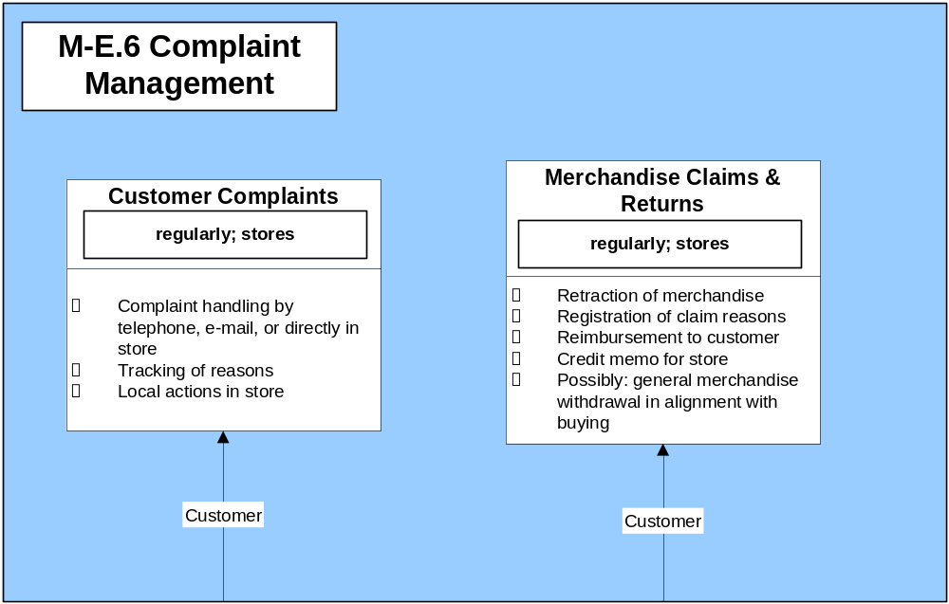
M-E.6 Complaint Management
Retractions &
Returns
Notes:
This is a generic component map for retail. The map is organized vertically by competency, and horizontally by operational level.
The three levels used in CBM are:
Plan is about strategy, overall direction and policy.
Manage is about monitoring, managing exceptions and tactical decision making
Execute is about doing the work

Slide 30
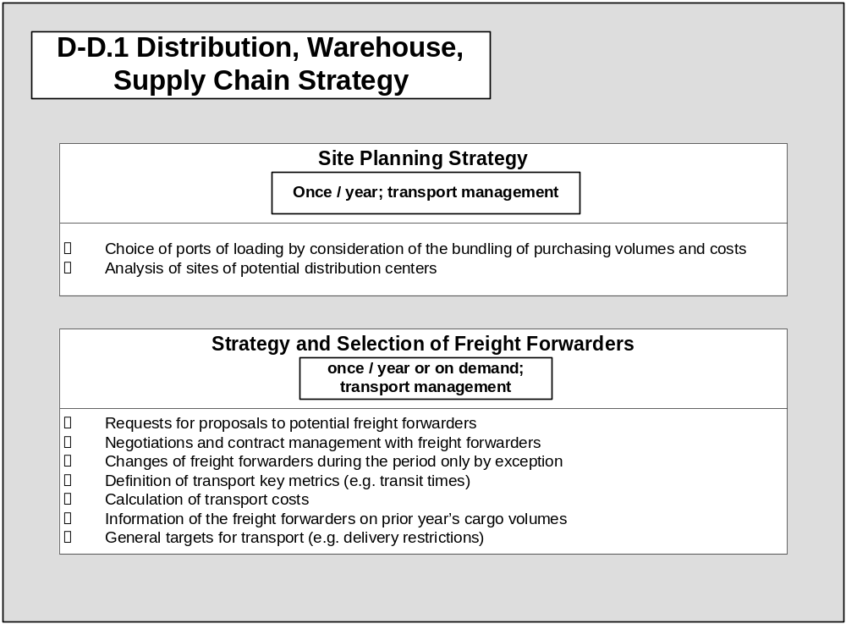
D-D.1 Distribution, Warehouse, Supply Chain Strategie
Notes:
This is a generic component map for retail. The map is organized vertically by competency, and horizontally by operational level.
The three levels used in CBM are:
Plan is about strategy, overall direction and policy.
Manage is about monitoring, managing exceptions and tactical decision making
Execute is about doing the work

Slide 31
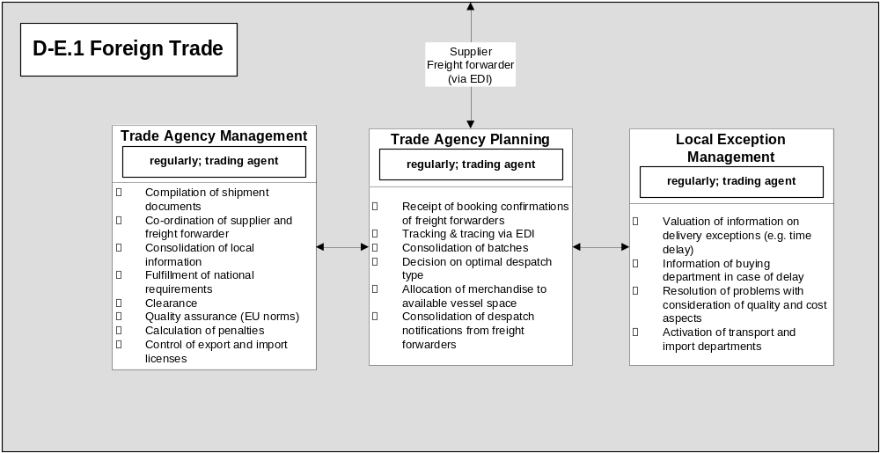
D-E.1 Foreign Trade
Transport Monitoring & Control
Customs
Operations
Management
Purchase Order
Management
Inbound Logistics
Exception Management
Notes:
This is a generic component map for retail. The map is organized vertically by competency, and horizontally by operational level.
The three levels used in CBM are:
Plan is about strategy, overall direction and policy.
Manage is about monitoring, managing exceptions and tactical decision making
Execute is about doing the work

Slide 32
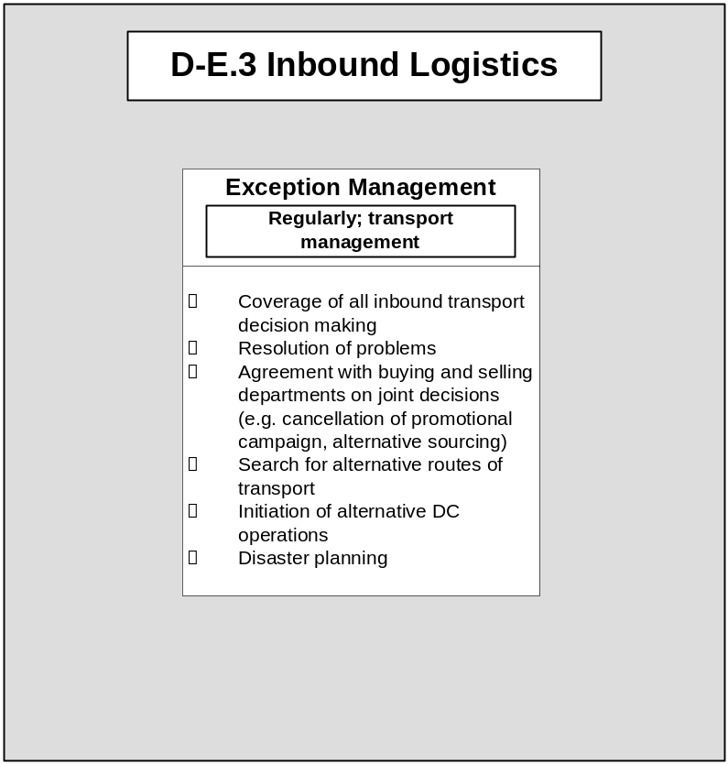
D-E.3 Inbound Logistics
Transport
Monitoring
& Control
Foreign Trade
Local Exception
Management
Goods Acceptance
In DC
Notes:
This is a generic component map for retail. The map is organized vertically by competency, and horizontally by operational level.
The three levels used in CBM are:
Plan is about strategy, overall direction and policy.
Manage is about monitoring, managing exceptions and tactical decision making
Execute is about doing the work

Slide 33
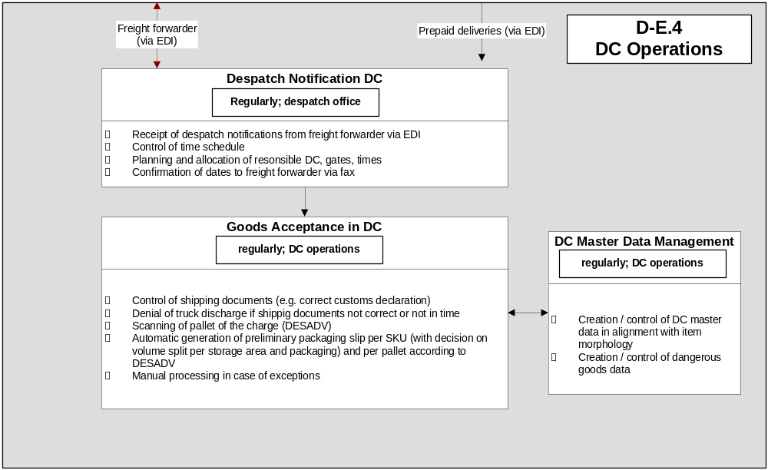
D-E.4 Distribution Center Operations (Goods Acceptance)
Inbound Logistics Tracking & Tracing
Transport Monitoring & Control
Returns Administration
Inbound Logistics
Exception Management
Setup / Assembly DC
(either Piece Pick
or Cross Dock)
D-E.4 Distribution Center Operations (Goods Intake)
Notes:
This is a generic component map for retail. The map is organized vertically by competency, and horizontally by operational level.
The three levels used in CBM are:
Plan is about strategy, overall direction and policy.
Manage is about monitoring, managing exceptions and tactical decision making
Execute is about doing the work

Slide 34
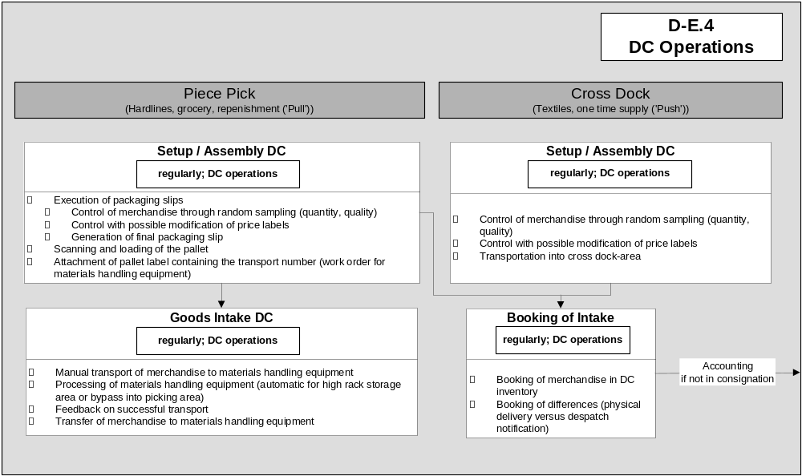
D-E.4 Distribution Center Operations (Goods Intake)
Goods Acceptance in DC
Goods Acceptance in DC
D-E.4 Distribution Center Operations (Goods Acceptance)
D-E.4 Distribution Center Operations (Picking / Cross Dock)
Notes:
This is a generic component map for retail. The map is organized vertically by competency, and horizontally by operational level.
The three levels used in CBM are:
Plan is about strategy, overall direction and policy.
Manage is about monitoring, managing exceptions and tactical decision making
Execute is about doing the work

Slide 35
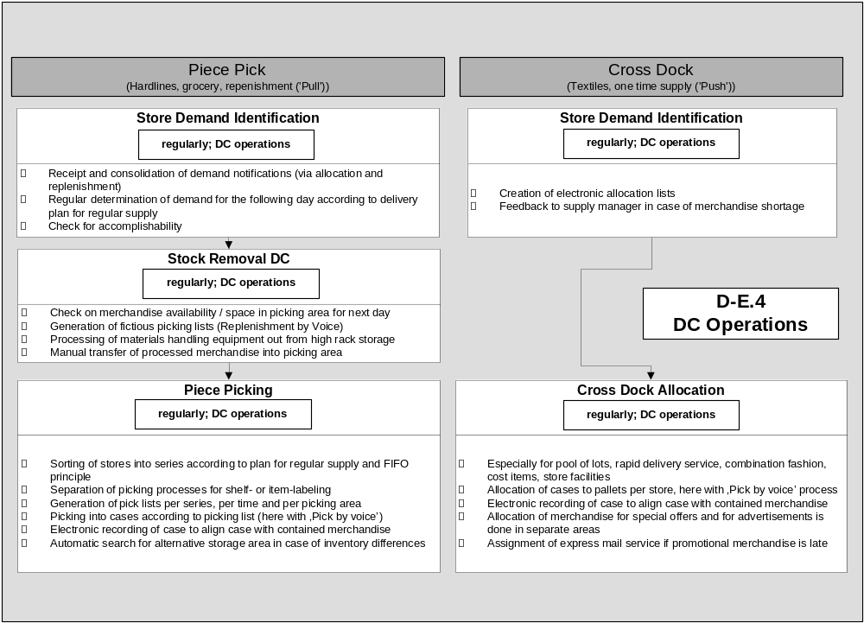
D-E.4 Distribution Center Operations (Picking / Cross Dock)
Purchase Order Management
for Replenishment
Allocation
D-E.4 Distribution
Center
Operations
(Goods
Intake)
D-E.4 Distribution Center
Operations (Goods Issue)
Consolidation
Consolidation
Notes:
This is a generic component map for retail. The map is organized vertically by competency, and horizontally by operational level.
The three levels used in CBM are:
Plan is about strategy, overall direction and policy.
Manage is about monitoring, managing exceptions and tactical decision making
Execute is about doing the work

Slide 36
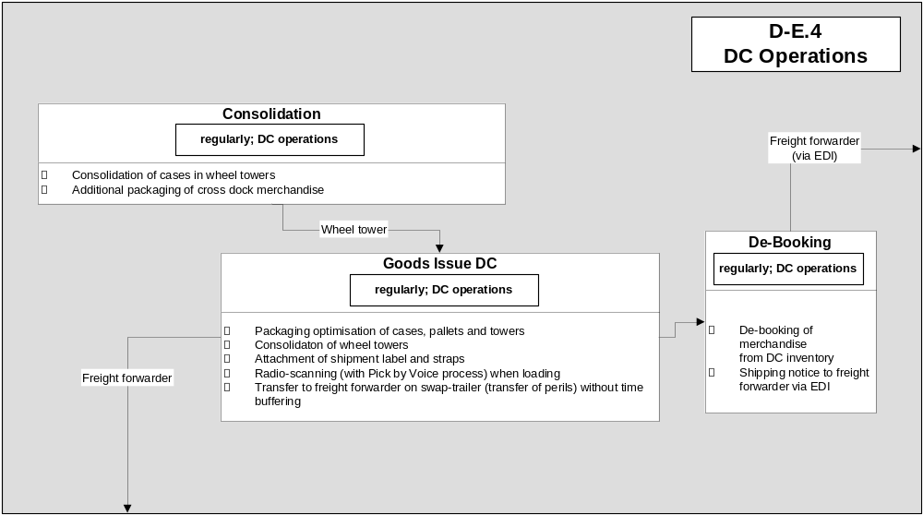
D-E.4 Distribution Center Operations (Goods Issue)
D-E.4 Distribution Center
Operations (Picking / Cross Dock)
Piece Picking
Cross Dock
Allocation
Outbound Logistics
Transport Monitoring & Control
Notes:
This is a generic component map for retail. The map is organized vertically by competency, and horizontally by operational level.
The three levels used in CBM are:
Plan is about strategy, overall direction and policy.
Manage is about monitoring, managing exceptions and tactical decision making
Execute is about doing the work

Slide 37
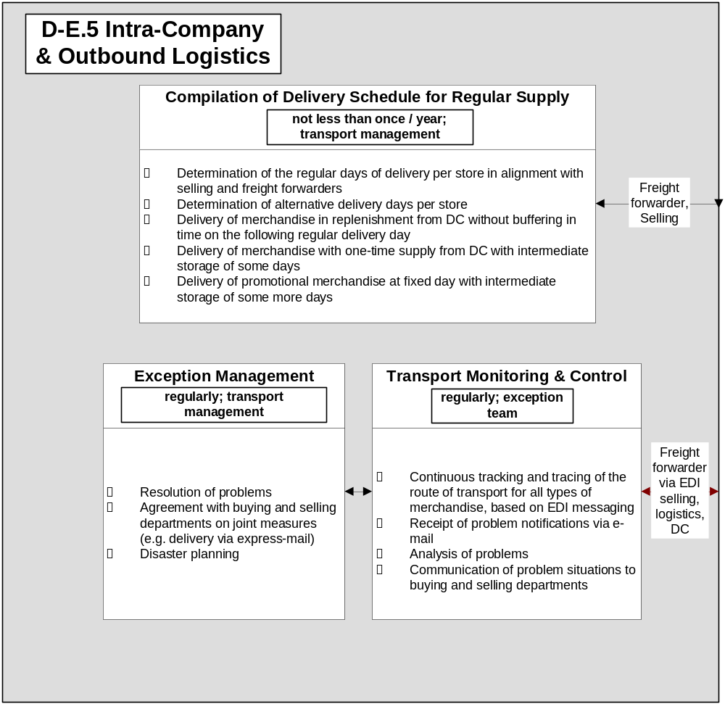
D-E.5 Intra-Company & Outbound Logistics
Supply
Management
Goods
Issue
DC
Intakes Store
Notes:
This is a generic component map for retail. The map is organized vertically by competency, and horizontally by operational level.
The three levels used in CBM are:
Plan is about strategy, overall direction and policy.
Manage is about monitoring, managing exceptions and tactical decision making
Execute is about doing the work

Slide 38
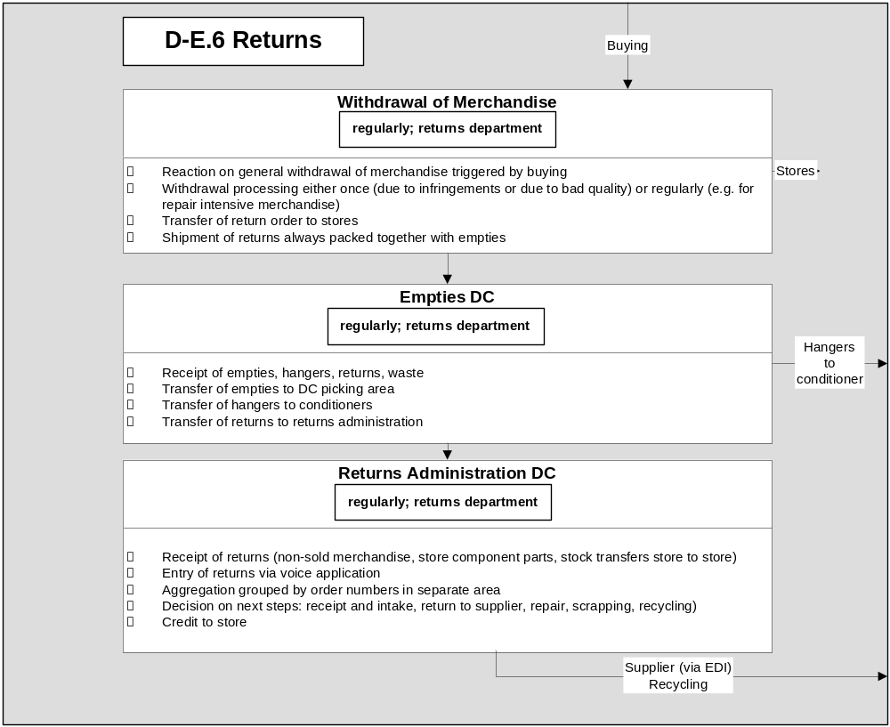
D-E.6 Returns
Retractions
& Returns
Goods
Acceptance
In DC
Notes:
This is a generic component map for retail. The map is organized vertically by competency, and horizontally by operational level.
The three levels used in CBM are:
Plan is about strategy, overall direction and policy.
Manage is about monitoring, managing exceptions and tactical decision making
Execute is about doing the work

Slide 39
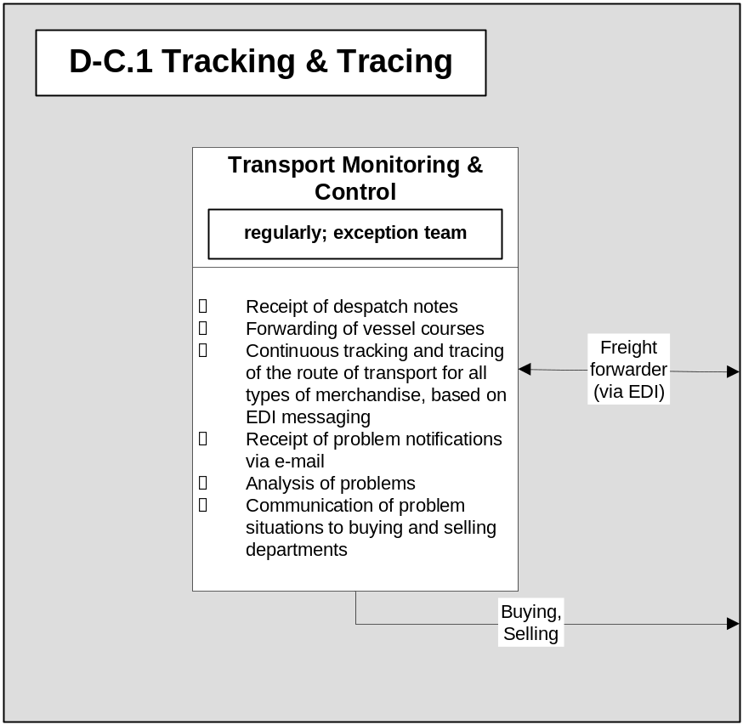
D-C.1 Tracking & Tracing
Trade Agency Management
Despatch Notification
in DC
Notes:
This is a generic component map for retail. The map is organized vertically by competency, and horizontally by operational level.
The three levels used in CBM are:
Plan is about strategy, overall direction and policy.
Manage is about monitoring, managing exceptions and tactical decision making
Execute is about doing the work

Slide 40
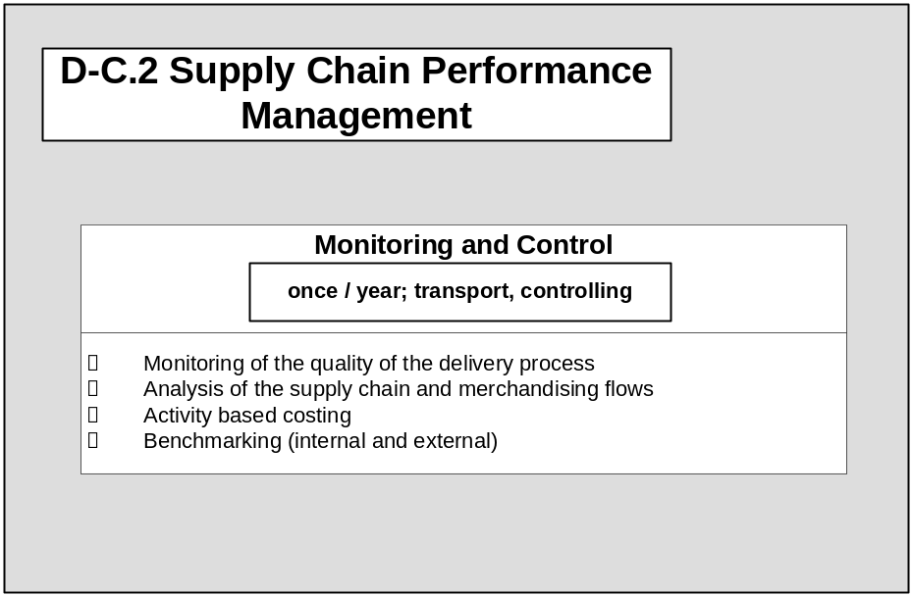
D-C.2 Supply Chain Performance Management
Notes:
This is a generic component map for retail. The map is organized vertically by competency, and horizontally by operational level.
The three levels used in CBM are:
Plan is about strategy, overall direction and policy.
Manage is about monitoring, managing exceptions and tactical decision making
Execute is about doing the work

Slide 41
How was the Retail Process Model created?
Has been developed for Deutsche Woolworth, a chain of department stores in Germany, former affiliate of Woolworth’s, and then generalized to overall retail business
Has been developed as part of an enterprise architecture project for the transition programme of the company, to support a holistic view on the enterprise and the projects of the transition programme
Depicts the full business process landscape of merchandising processes, including buying, logistics, and selling, of a typical department store chain in the low price segment
The CBM for Retail of IBM has been used as the starting point of the analysis, to provide level zero of the business maps
Can be used to understand in more depth the business processes of Retail, as a detailing of the CBM
An additional view is provided by the Component Business Flow (‘CBF’) which depicts the dependencies of the business components, to better understand the overall context
It is highly recommended to study the CBF before drilling down into details
The original document is Visio, that can be modified due to individual needs
Notes:
This is a generic component map for retail. The map is organized vertically by competency, and horizontally by operational level.
The three levels used in CBM are:
Plan is about strategy, overall direction and policy.
Manage is about monitoring, managing exceptions and tactical decision making
Execute is about doing the work

Slide 42
How to Use the Retail Process Model?
Component Business
Model Main Menu
Suppliers
Products
Store & Channel
Marketing & Customer Management
Distribution & Warehousing
Main Flow of Planning
P-E.3 Import & Customs
D-E.1 Foreign Trade
D-D.1 Distribution, Warehouse, SC Strategy
Direct
S-D.1 Supplier Relationship Strategy
P-D.1 Merchandise / Brand Strategy
C-D.1 Store & Channel Strategy
M-D.1 Customer Relationship Strategy
D-D.1 Distribution, Ware-house, SC Strategy
Main Physical Flow of Merchandise
D-E.3 In-bound Logistics
D-C.1 Tracking & Tracing
S-D.2 Supplier Relationship Planning
P-D.2 Merchandise Planning
C-D.2 Real Estate
Planning and Development
M-D.2 Marketing Strategy & CBM Retail MapPlanning
D-D.2 Site and Transportation Planning
P-D.1 Merchandise / Brand Strategy
S-D.3 Supplier Relationship Management
S-E.1 Supplier
Operations
Management
P-E.5 Allocation
D-C.2 Supply Chain Performance Management
S-D.3 Supplier Relationship Management
P-D.3 Assortment Planning
C-D.3 Merchandise & Location Planning
D-D.3 Transportation Strategic Partnerships
Execute
P-E.1 Sourcing and Listing
P-D.4 Category Management
M-E.1 Mass Marketing and Advertising
P-D.2 Merchandise Planning
D-E.4 Distribution Center Operations
S-E.1 Supplier Operations Management
P-E.2 Purchase Order Management
C-E.1 Store and Channel
Design & Layout
M-E.2 Target Marketing
D-E.1 Foreign Trade
P-E.1 Sourcing and Listing
S-C.1 Supplier Performance Management
S-E.2 Supplier Transaction Management
C-E.2 Space Planning
D-E.2 Transportation / Fleet Management
C-D.3 Merchandise & Location Planning
P-D.3 Assortment Planning
P-E.2 Purchase
Order Management
P-E.3 Import & Customs
C-E.3 Visual Merchandising
M-E.3 Loyalty Program
D-E.3 In-bound Logistics
Click on Home Buttons
(from any menu):
Return to CB Model Main Menu
or to CB Flow Main Menu
P-C.1 Product Performance Management
P-E.4 Master Data Management
P-E.5 Allocation
C-E.4 Price / Promotions Management
M-E.4 Customer Service and Communications
D-E.4 Distribution Center Operations
C-E.2 Space Planning
P-E.6 Replenishment
P-E.6 Replenishment
C-E.5 Store and Channel Operations
M-E.5 Multi Channel Call Center
D-E.5 Intra-company & Outbound Logistics
P-C.2
Merchandise
Plan Tracking
C-C.2 Merch & Loc Plan Tracking
Control
S-C.1 Supplier Performance Management
C-C.1 Store Operations Central Control
M-E.6 Complaint Management
D-E.6 Returns
C-D.1 Store
& Channel
Strategy
C-D.2 Real Estate
Planning and Development
C-E.1 Store Channel
Design &
Layout
C-E.3 Visual Merchandising
C-E.4 Price / Promotions Management
P-C.1 Product Performance Management
M-C.1 Market & Competitor Research
D-C.1 Tracking & Tracing
S-C.2 Supplier Lifecycle Management
P-C.2 Merchandise Plan Tracking
C-C.2 Merchandise & Location Plan Tracking
M-C.2 Consumer Behavior and Segmentation
D-C.2 Supply Chain Performance Management
M-E.1 Mass Marketing and Advertising
C-C.1 Store Operations Central Control
C-E.5 Store and Channel Operations
P-C.3 Product Lifecycle Management
C-C.3 Store Lifecycle Management
M-C.3 Consumer Performance Management
D-E.5 Intra-company & Outbound Logistics
M-C.4 Consumer Lifecycle Management
M-E.6 Complaint Management
D-E.6 Returns
M-E.1 Mass Marketing and Advertising
M-E.1 Mass Marketing and Advertising
Component Business
Flow Main Menu
Click on any Business Component:
Drill Down to Process Flow of this component
P-C.1 Product Performance Management
M-E.1 Mass Marketing & Advertising
S-C.1 Supplier Performance Management
…
Process Map
Advertisement
Calendar
Sourcing
and
Listing
Supplier
Performance
Management
Sourcing
and
Listing
Supplier
Performance
Management
Supply
Management
Process Maps
Click on Process Dependence Arrows:
Move forward / backward between Process Maps
Notes:
This is a generic component map for retail. The map is organized vertically by competency, and horizontally by operational level.
The three levels used in CBM are:
Plan is about strategy, overall direction and policy.
Manage is about monitoring, managing exceptions and tactical decision making
Execute is about doing the work

